Slide 1

Coffee Sales Analysis

Slide 2
Description:
In response to the needs of Coffee Cup's Senior Management Team comprising VPs and Directors, our data analysis aims to provide valuable insights from the provided data sets for the years 2018 and 2019. Using advanced tools such as Microsoft Excel, we've conducted a comprehensive analysis to uncover trends, patterns, and key takeaways that will help in informed decision-making and strategic planning.

Slide 3
Quality of the Data:
There are no duplicate entries in the data, simplifying the analysis process.
The date format in the dataset remains constant and unfiltered. To conduct analysis, the format needed adjustment.
The dataset included 2 entries dated 2012 in sales data, which were inaccurate. These entries were removed to focus on insights for 2018 and 2019.
There are no missing values in the dataset.
The data looks quite complete, including important details like sales, profits, market, category, product, and inventory levels.

Slide 4
Key Performance Questions:
What were the real profits earned from each market? The data shows how much money was gained or lost in each product market, helping us understand how well different markets did financially.
How did the sales do each year? This information helps us see how sales went up or down every month and year. It helps us figure out problems and even guess how sales might be in the future.
Did we meet the profit % we aimed for? The data gives us the exact profit % numbers. This helps us see if we reached our goal and how we can make more profit based on our plans.
Did coffee or food sell more? The data gives us the total sales for the top categories. This helps us decide what menu items to add or change in the category that's making the most money.
How many stores are there in provinces with good sales and profits? The data shows the total number of stores in each province. This helps us see which province makes more money and decide how many more stores we could open to increase sales.

Slide 5

Additional Questions:
What food items are often bought along with hot coffee? The data should include the details of customer purchase that shows which food items were bought together with coffee in various transactions.
How many orders were delivered on time? The data should provide information about orders that were delivered within the expected timeframe. This helps us assess if we're meeting our service level agreements (SLA) and determine if any adjustments are needed in the order delivery process.
What are customers saying about the product? The data should consist of customer reviews and complaints, which help us grasp the product's market impact and decide if any adjustments are needed for improvement.
How many skilled baristas are employed in each store? The data should show the number of trained baristas in each store. This information helps us determine if we need to hire and train more baristas, especially for stores that are experiencing delays in order completion.
Have there been any recent menu changes, and if yes, how did they influence sales of food and hot drinks? We need information about recent menu updates and sales data. By comparing sales before and after menu changes, We can understand how they affected the sales of food items and hot drinks.

Slide 6
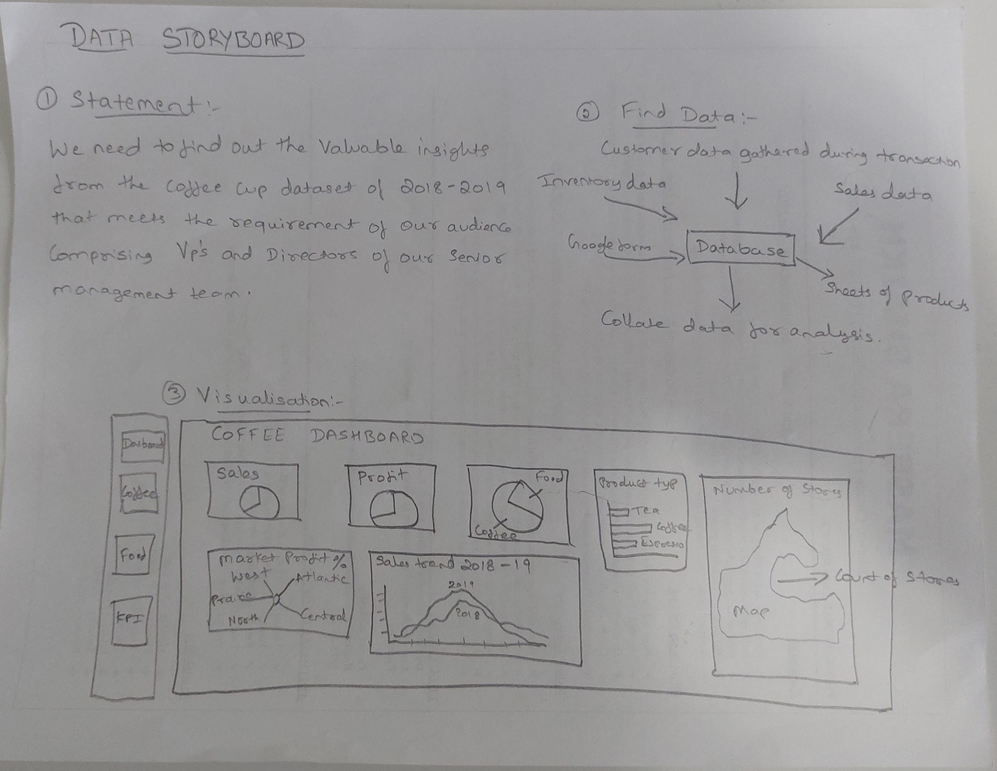
Data Storyboard

Slide 7
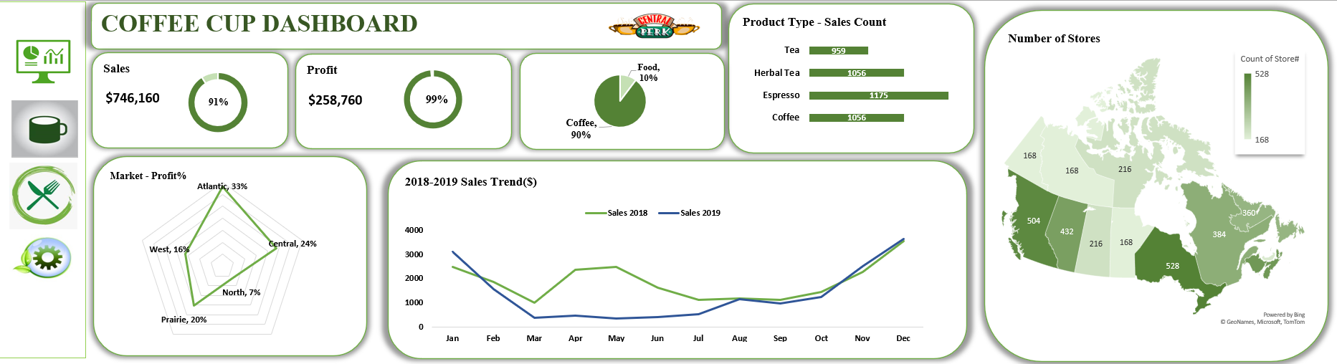
Visual Dashboard with helpful graphs and charts
Note: I have attached the Excel file containing the dashboard for your reference.

Slide 8
Dashboard Instructions:
Parameter Switching: Easily switch between different views using the provided options.
Raw Data Access: Click on sections to see detailed raw data.
Target Progress: Check how actual Sales and Profit compare to targets.
Yearly Sales Trend: See how sales changed from 2018 to 2019.
Store Counts: View store numbers in each province.
Profit by Market: Understand profits from different markets.

Slide 9
Design Techniques
Patterns: Employed various designs to present data in a way that helps the audience understand key points, like Market Profit % and Store Counts in each province.
Data Comparison: Used visuals to display how data differs and resembles each other, like showing Sales Trend and Product Categories.
Labels: Included clear labels in each visual to explain charts or graphs and make them easy to understand.
Color Scheme: Picked matching colors that go with the brand and kept them the same across different parts of the dashboard.
White Space: Made good use of empty space to avoid a messy look and make everything easy to read. Putting enough space between things makes the dashboard neat and not too busy.

Slide 10


THANK YOU!

